Slide 1
Interconnections
Geographies of Interconnections
Year 9

Slide 2
What does it mean?
We are all products of our surroundings.
What shapes us as individuals?
The location where we live (town, farm, apartment, nation)
The immediate local environment (wheatbelt – meagacity)
Personal Geography – the way in which we view and make sense of the world around us. Personal Geography grows as we become older due to experiences and exploring what life offers.
Young adults routinely leave move away from their home and return when older.

Slide 3
Place Perception
Write these questions in your notes and answer in your own words:
What does Place Perception mean?
How do we arrive at our perceptions of place?
Place Perception: refers to our awareness of places and opinions we have of locations/places.
Perception of the same place differs from person to person.
Feelings and interpretations influence decisions and opinions of place. Personal meaning and significance ie. a special memory of a family holiday.

Slide 4
Filters
Filters: Personal and Group characteristics:
Race
Gender
Nationality
Age
Religious beliefs
Time in which people live
Places are arranged to orient, navigate, alienate:
Paths
Edges
Districts
Landmarks

Slide 5
Familiarity
Familiarity shapes behaviour.
Why do you make the choices you do?
Gender and Danger
Men are more likely to experience violence
Womens’ fear of violence is greater
Perception of danger affects leisure spaces and accessibility.

Slide 6
Shell Beach
Shell Beach is located 45 kilometres south-east of Denham in the Shark Bat World Heritage area .
This beautiful snow-white beach is made up of millions of tiny shells up to 10 metres deep and stretching for over 70 kilometres.

Slide 7
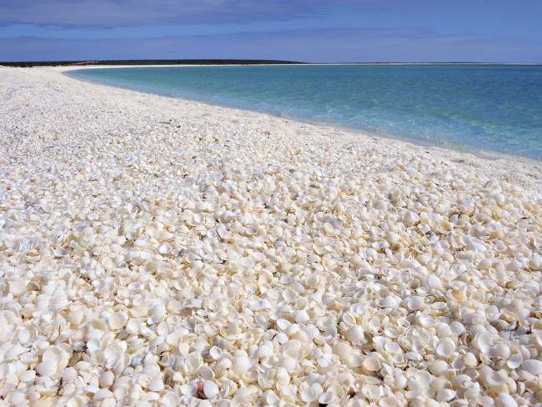
Shell Beach

Slide 8
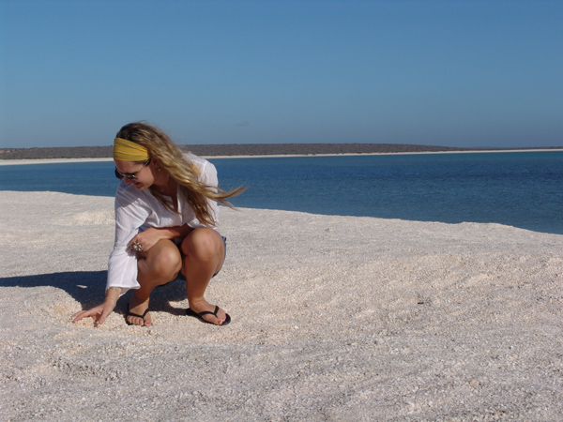
Shell Beach

Slide 9
Monkey Mia Dolphins
The friendly pod of wild bottlenose dolphins regularly swim to Monkey Mia’s shore to interact with humans up to three times a day.
This often occurs more frequently in the mornings, with feeding times occurring between 7.30am and 12 noon.
Renowned as one of the best and most reliable places for dolphin interaction in the world, Monkey Mia is the only place in Australia where dolphins visit daily, not just seasonally.
The Department of Parks and Wildlife (DPAW) established Monkey Mia as a marine reserve in 1990.
A designated interaction area was created to help protect the dolphins, while allowing selected visitors to feed them during designated feeding times.
A small entry fee must be paid to enter the reserve, but the dolphin interaction is free.

Slide 10
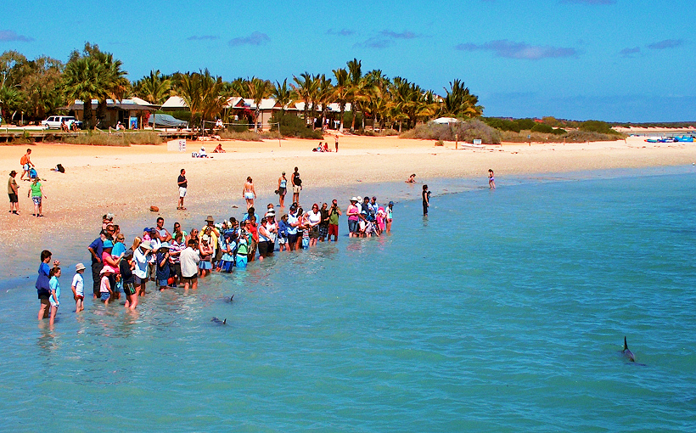
Monkey Mia

Slide 11
Identify places
1. Identify a place you love with great memories attached.
Identify the reasons why you are connected to that place
2. Describe your hometown/family home. What are your feelings about it?
Identify the reasons why you feel the way you do.

